Slide 1

WORDPRESS CLIENT
Presented By : GROUP 16
USTH | 2024

Slide 2

1
TEAM MEMBER
Nguyễn Văn Giang - 22BI13132 (Leader)
Nguyễn Minh Đức - 22BI13092
Nguyễn Vũ Huy Khôi - 22BI13222
Lưu Anh Đức - 22BI13088
Hà Lê Hoàng - 22BI13170
Nguyễn Hoàng Phương Nam - 22BI13323
USTH | 2024

Slide 3

OVERVIEW
2
Introduction
Optimization
Architecture
Demo (with emulator)
Activities
Conclusion
USTH | 2024

Slide 4



3
INTRODUCTION
PURPOSE
Manage
Interaction
Analytics
USTH | 2024

Slide 5


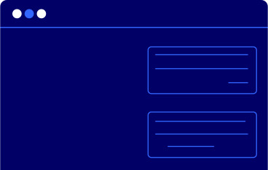
4
INTRODUCTION
BENEFIT
Comprehensiveness
Speed & Security
Theme Library
USTH | 2024

Slide 6
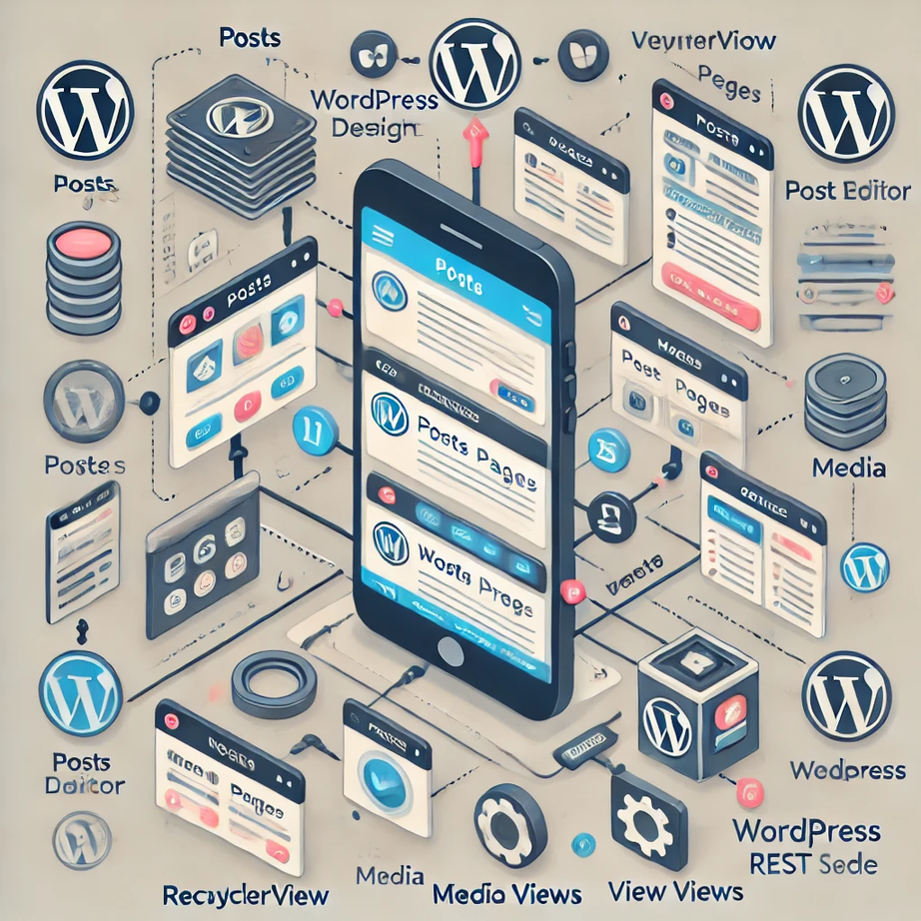
5
ARCHITECTURE
USTH | 2024

Slide 7









ARCHITECTURE
6
Pages
USTH | 2024
Posts
Login
Create sites
Sites Management
Setting and Logout
Comeback ?
Welcome
Media
Comments

Slide 8
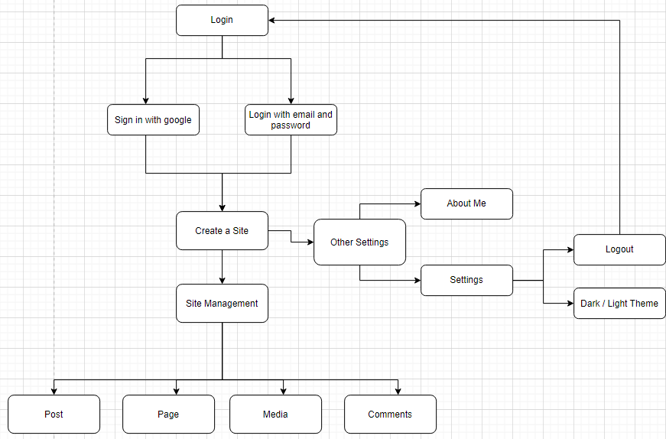
ARCHITECTURE
7
USTH | 2024

Slide 9
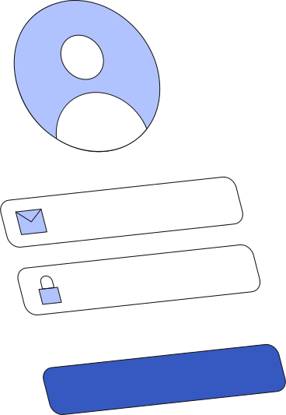


8
ACTIVITIES
Login
Login with email and password
USTH | 2024
Sign in with Google

Slide 10
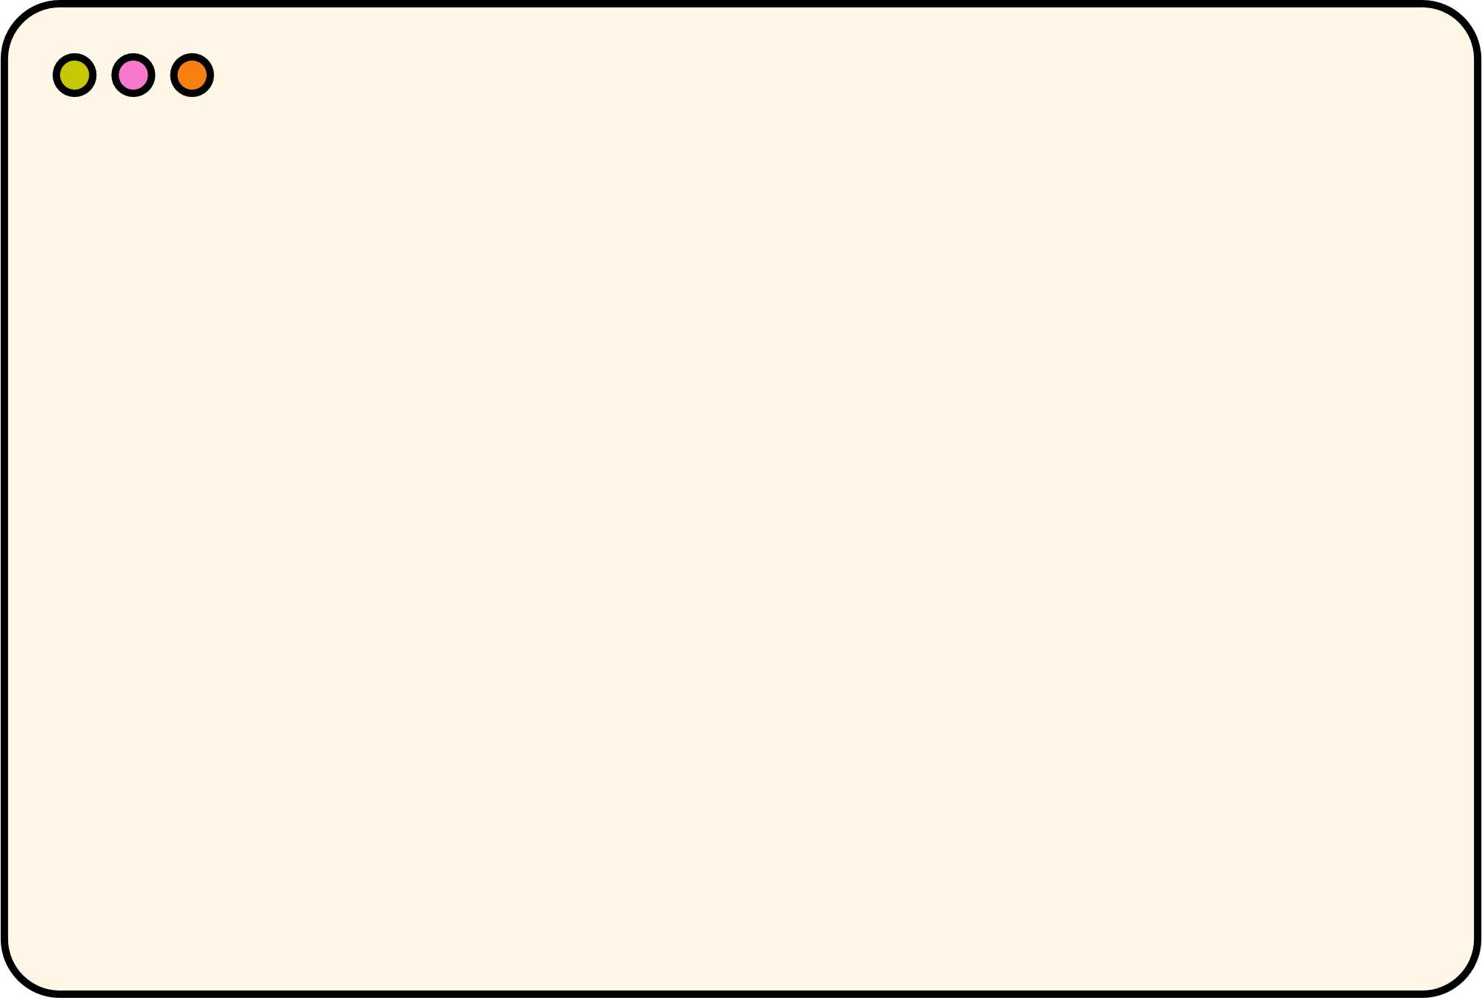
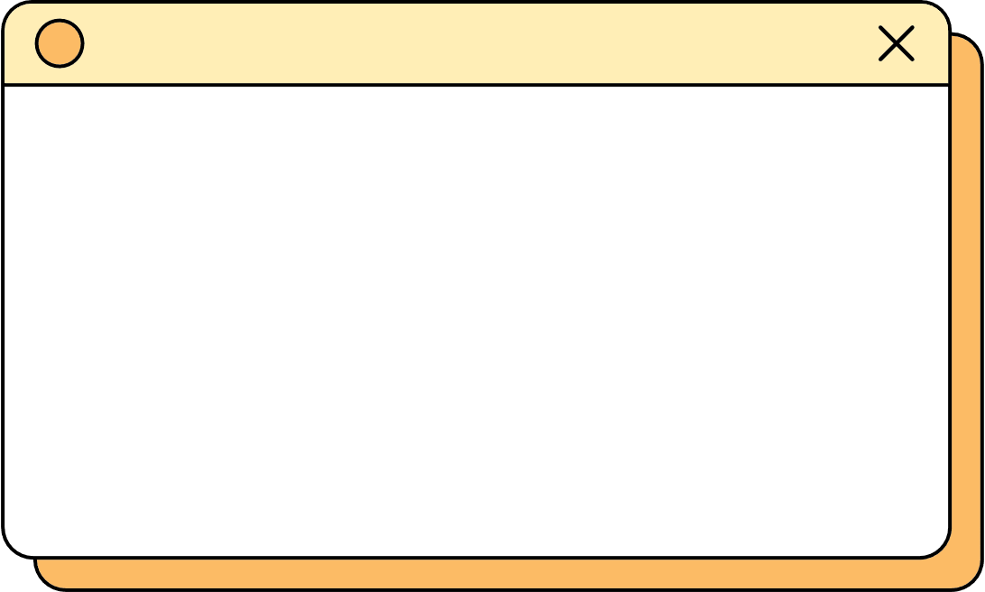




9
ACTIVITIES
Create sites
USTH | 2024
Create, develop and maintain your own domain.

Slide 11






10
ACTIVITIES
Site Management
Pages
Posts
Media
Comments
About me
USTH | 2024

Slide 12



11
ACTIVITIES
Setting
Dark/Light mode
USTH | 2024
Support Vietnamese

Slide 13

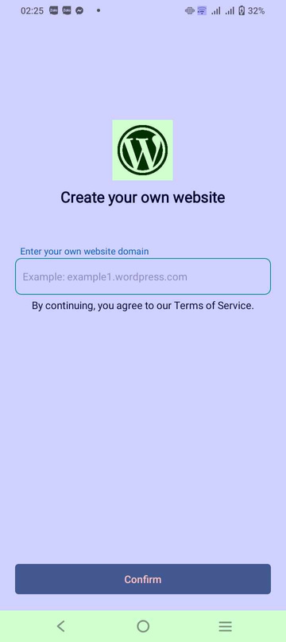
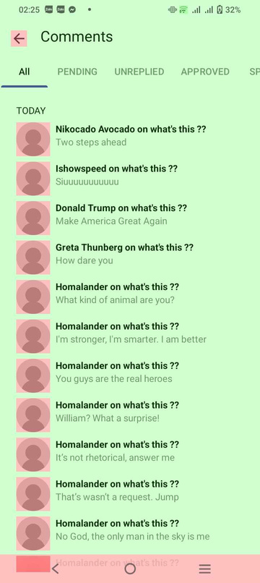
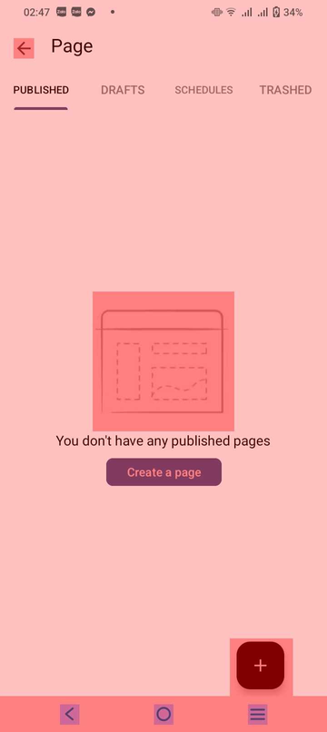
12
OPTIMIZATION
Layout Overdraw
USTH | 2024
1x Overdraw
2x Overdraw
3x Overdraw

Slide 14
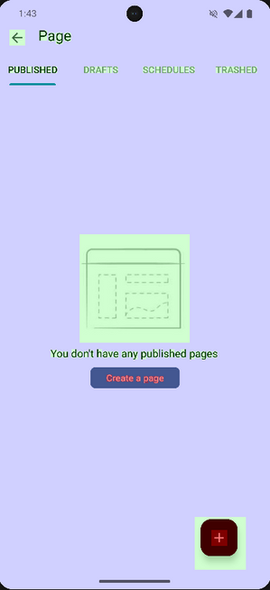
13
OPTIMIZATION
Layout Overdraw
USTH | 2024
optimized
Before
After

Slide 15

CONCLUSION
14
USTH | 2024

Slide 16






COMPLETED TASKS
15
Dark/light theme
multi language
RecyclerView
Comment activites
Post activites
Page activites

Slide 17
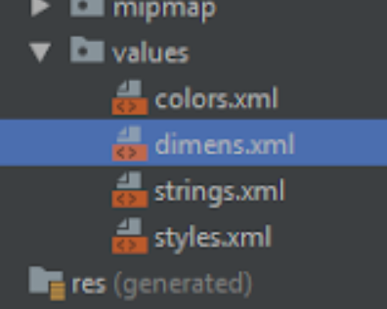
16
UNFINISHED TASKS
Organized dimens values
USTH | 2024

Slide 18

17
CONCLUSION
Future improvements
-Structuring dimension values.
-Mimics more behaviors of real Wordpress app.
-Optimization design for user experience .
USTH | 2024

Slide 19



USTH | 2024
ANY QUESTION ?
Please don’t hesitate to ask

